Slide 1
Computational modeling of cardiovascular response to orthostatic stress 2002
THOMAS HELDT,1EUNB.SHIM,2ROGER D. KAMM,3AND ROGER G. MARK1

Slide 2
Past Modelling Efforts
HUT
LBNP
42 - Leonard JI, Leach CS, and Rummel JA.Computer simula-tions of postural change, water immersion, and bedrest: anintegrative approach for understanding the spaceflight response.Physiologist22: S31–S32, 1979.
11 – seven-compartment of cardiovascular system +arterial baroreflex and cardiopulmonary baroreflex - Boyers DG, Cuthbertson JG, and Luetscher JA.Simulationof the human cardiovascular system: a model with normal re-sponse to change in posture, blood loss, transfusion, and auto-nomic blockade.Simulation18: 197–205, 1972
18 – similar to 11 but 28-compartment similar to this paper Croston RC and Fitzjerrell DG.Cardiovascular model for thesimulation of exercise, lower body negative pressure, and tilttable experiments. In:Proc 5th Ann Pittsburgh Conf ModelingSimulation 1974, 471–476
80 White RJ, Fitzjerrell DG, and Croston RC.Fundamentals of lumped compartmental modelling of the cardiovascular system.In:Advances in Cardiovascular Physics. Basel: Karger, 1983,vol. 5, pt. I, p. 162–184.
50 – LBNP hemodynamic response Melchior FM, Srinivasan RS, and Cle` re JM.Mathematical modeling of the human response to LBNP.Physiologist35,Suppl1: S204–S205, 1992.
72 finite-element model effects of LBNP on regional blood flow
Sud VK, Srinivasan R, Charles JB, and Bungo MW.Effectsof lower body negative pressure on bloodflow with applicationsto the human cardiovascular system.Med Biol Eng Comput31:569–575, 1993.
51 – Extension of 18, refined model. Melchior FM, Srinivasan RS, Thullier PH, and Cle` re JM.Simulation of cardiovascular response to lower body negativepressure from 0 mmHg to40 mmHg.J Appl Physiol77:630–640, 1994

Slide 3
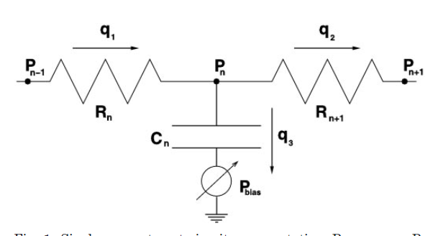
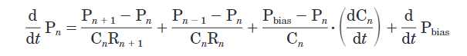

Slide 4
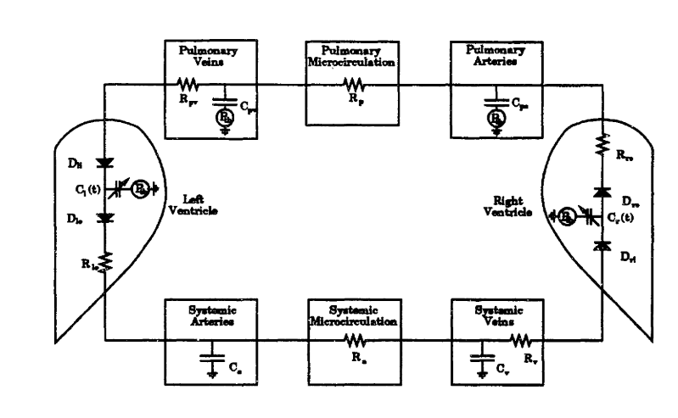
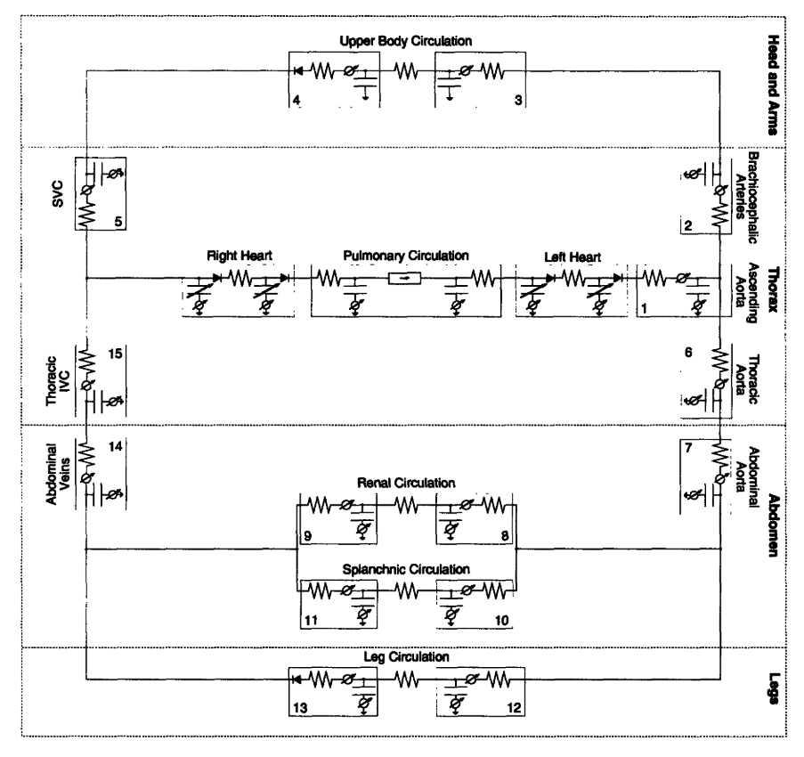
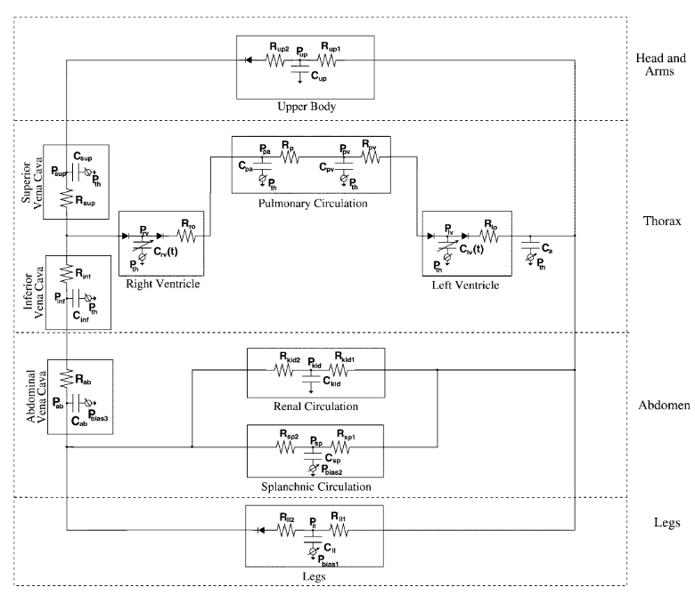

Slide 5
P_{lv}
_{Qaa ->}
P_{g_aa}
P_{aa}
R_{lv}
C_{aa}
P_{th}

